Slide 1

SYRIALTEL CUSTOMER CHURN
By NYAMBURA
On 05/06/2025​

Slide 2
Agenda
1
2
3
4
5
Introduction
Objectives
Visualizations
Analysis
Recommendations & conclusion

Slide 3

Introduction
- Customer Churn is the loss of clients or customers.
- The analysis is conducted in Python 3.8.5 using jupyter notebook which allows is to create an interactive environment which includes live code, visualization and text.

Slide 4

Objectives
Identify Key Behavioral and Demographic Factors Influencing Churn.
(II) Profile At-Risk Customers to Support Targeted Business Interventions.
(III) Build an Accurate Churn Prediction Model.
(IV) Identify Key Drivers of Customer Churn.

Slide 5
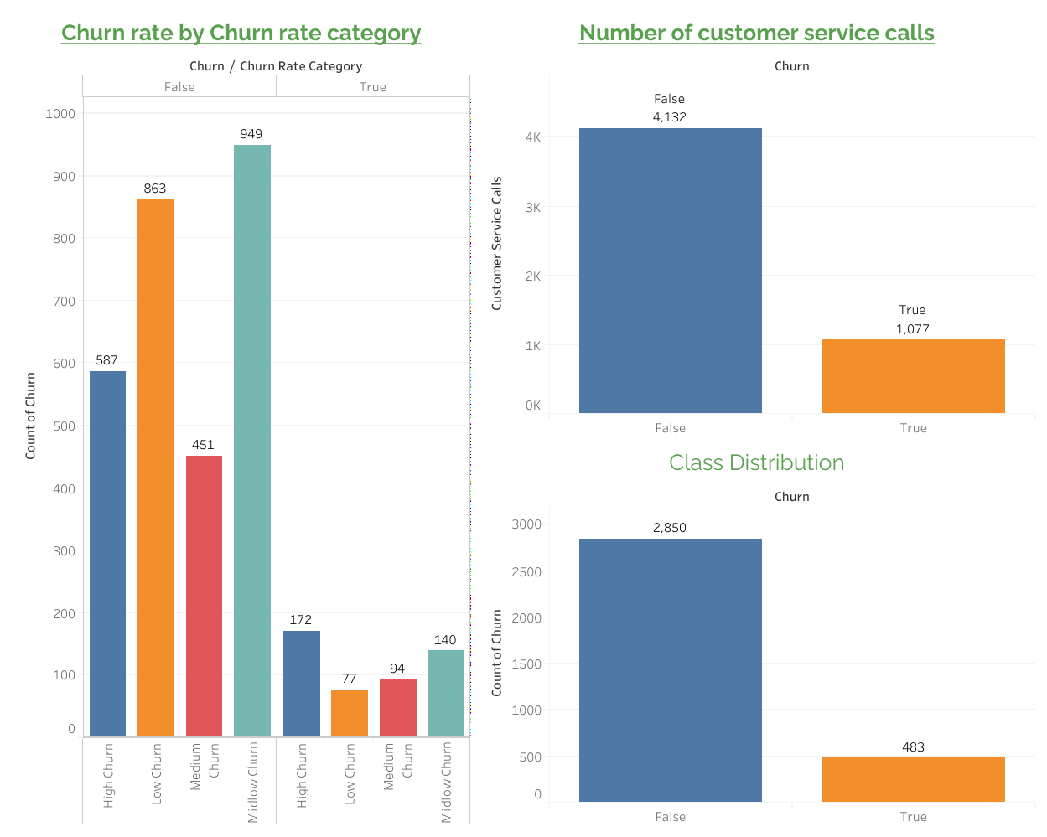
Visualizations

Slide 6
Model Comparison
Model | Accuracy | Precision | Recall | F1-Score | AUC
Logistic Reg | 76% | 0.34 | 0.69 | 0.45 | 0.72
Decision Tree | 93% | 0.75 | 0.78 | 0.76 | 0.87

Slide 7
Decision Tree model is used for churn prediction if maximizing detection is the top priority. However, Logistic Regression model is also considered if business stakeholders require explainability or if model generalization is critical
“
”
Nyambura

Slide 8





Recommendations
Implement a Proactive Retention Program for High-Risk Customers
Enhance Customer Service Quality and Responsiveness
Offer Affordable International Call Packages.
Promote Value-Added Services Through Bundling.

Slide 9

Conclusion
For Business
Executives
Our churn prediction model provides SyriaTel with a powerful, data-driven approach to customer retention. By identifying key drivers of churn—such as limited service engagement and frequent complaints—we can now flag at-risk customers with high accuracy.
For technical
Audience
Using classification algorithms and extensive feature engineering, we developed a churn prediction model that achieves strong performance, with , F1-score of 0.76. Key predictors include service call frequency, total day minutes, and number of customer service calls.

Slide 10

Thank you

